Slide 1

SOCIAL NETWORKING SITE
K SIDHARTH RAO :-2010030443
C SAI SANTOSH :- 2010030033
P VINAY KUMAR :-2010030469

Slide 2
ABSTRACT
Social media platforms play an increasingly important role in research, education, and clinical practice. As an inseparable part of open science, these platforms may increase the visibility of research outputs and facilitate scholarly networking.
The editors who ethically moderate Twitter, Facebook, and other popular social media accounts for their journals may engage influential authors in the post-publication communication and expand societal implications of their publications

Slide 3
INTRODUCTION
Social media is an internet-based form of communication. Social media platforms allow users to have conversations, share information and create web content. Social media, if used properly, can help people of all age groups get benefitted from it.
Thus, we have decided to create a Social Media Site for our college, where all the faculty and students can share information, chat with people and have discussions which benefits the students in various ways.
Users have to create an account by giving the necessary details. Their details will be stored in the database and the next time user can directly log-in.
We provide the options of uploading pictures and statuses, chatting with friends, liking pictures upload by friends.
We have secured OTP system, which prevents any kind of data leakage as such.

Slide 4
LITERATURE REVIEW
The term “social media” (SM) was first used in 1994 on a Tokyo online media environment, called Matisse.1 It was in these early days of the commercial Internet that the first SM platforms were developed and launched. Over time, both the number of SM platforms and the number of active SM users have increased significantly, making it one of the most important applications of the Internet.
In research, SM is generally used as an umbrella term that describes a variety of online platforms, including blogs, business networks, collaborative projects, enterprise social networks (SN), forums, microblogs, photo sharing, products review, social bookmarking, social gaming, SN, video sharing, and virtual worlds.4 Given this broad spectrum of SM platforms, the applications of SM are quite diverse and not limited to sharing holiday snapshots or advertising and promotion.

Slide 5
It is estimated that close to 100 percent of larger companies (both B2C and B2B) are using some sort of SM platform to inform their customers, gather information, receive feedback, provide after-sales service or consultancy, and promote their products or services. The key characteristic that makes SM so relevant for companies is the fact that SM allows for two-way communication between the brand and the customer.
According to Liana Evans (2010) with the hype of social media, companies think it is easy to succeed online, thinking that all they need is a Facebook page to hit their audience, but that is not enough. People will continue to share conversations and experiences without a company’s involvement. The appeal for Socialmedia is cross generations; some of the fast growing demographics are those of above 40 years old.

Slide 6
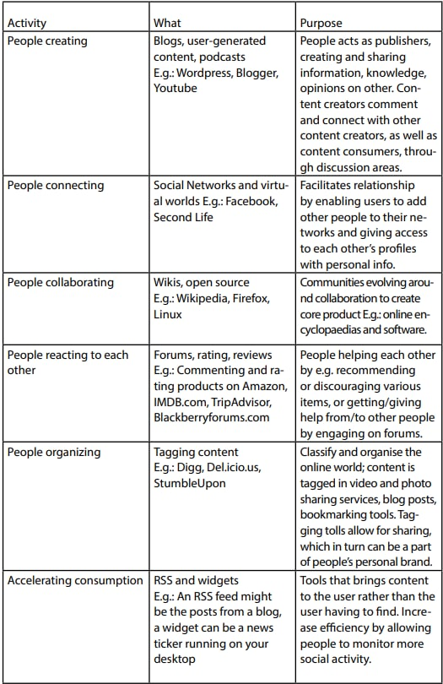
CLASSIFICATION OF SOCIAL MEDIA

Slide 7
TOOLS REQUIRED
MYSQL
JAVA
ECLIPSE ENTERPRISE EDITION
APACHE TOMCAT v9.0

Slide 8
FLOWCHART
STEP1:- REGISTRATION
STEP2:-LOGIN
STEP3:-HOME PAGE
STEP4:-PROFLE PAGE
STEP5:-LOGOUT

Slide 9
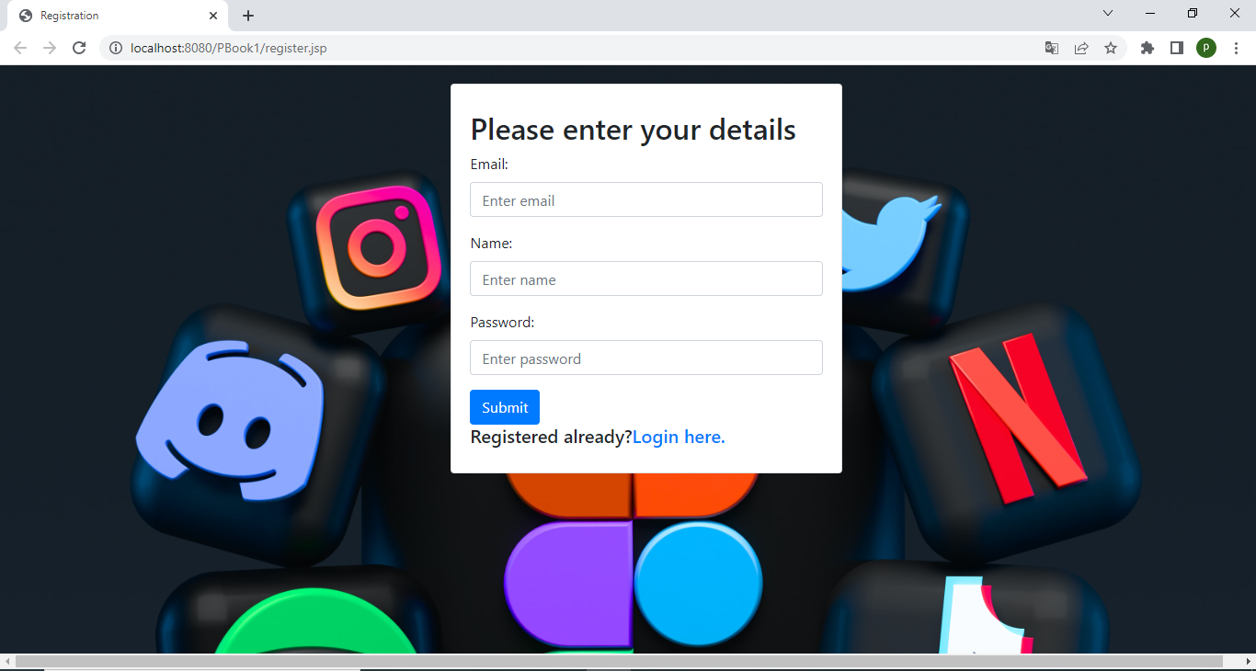
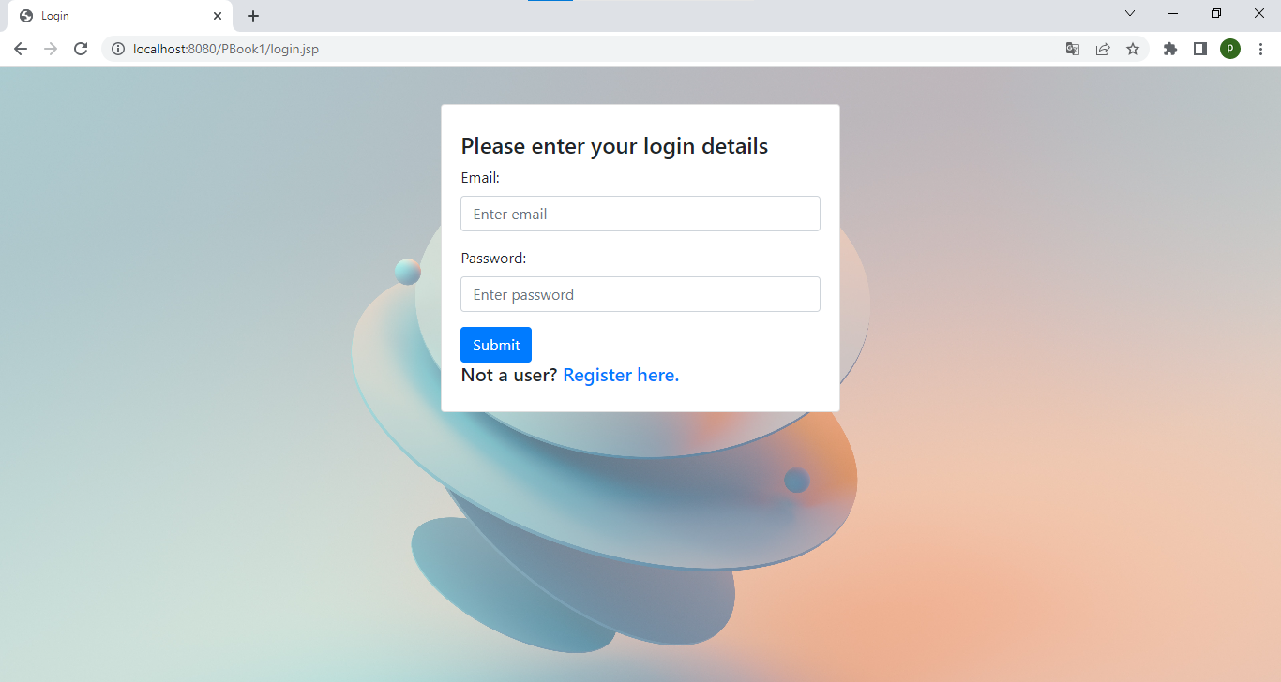
WORK IN PROGRESS

Slide 10
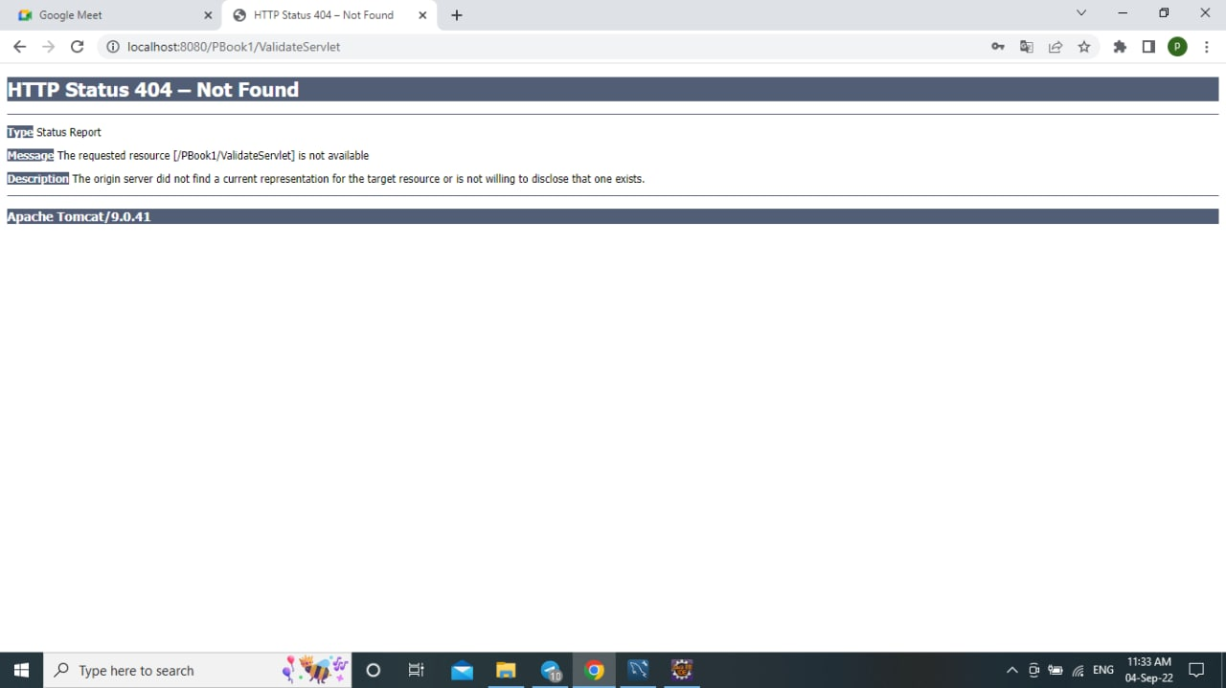
ALPHA TESTING

Slide 11
CONCLUSION
In this project, we will be developing a Social Media platform, exclusively for the students at KL University. This platform will be very useful in sharing information and insights regarding various things, which will be helpful for the growth of students in general.
We will be developing this project in such a way that the students will be getting the maximum benefit by it, as we have no recommendation service provided, there will be no scope of getting diverted and spending time on unnecessary sites.
This project enables the alumni and faculty to share information and experiences which will help the students to gain an insight.

Slide 12




THANK YOU

